Slide 1
Exploring the Economic Impact of Recessions in the last 100 Years
By
Arkhawan Salih
Phillip Poole
Adam Afridi

Slide 2

Agenda
01 | | Background & Methodology Our Learning Goals and Approach
02 | | Total Personal Consumption Expenditures (API)
03 | | Average Personal Income (API)
04 | | Inflation Trend (CSV)
05 | | Executive Summary What We Learned

Slide 3
Background and Objectives
Background
Many are looking to past financial crises to help make sense of what we’re currently experiencing with the Covid-19 fallout. Looking to the past could help us predict possible economic outcomes from the current aftermath. We’ll investigate how the recent financial crisis of 2008 impacted various metrics such as income, inflation, and personal expenditures. We’ll also look at Great Depression data to determine the time frame of personal income recovery.
Objectives
Specific questions we’re looking to answer in this research include the following:
How did personal consumption expenditures fluctuate during the most recent financial crisis of 2008 nationwide and in Illinois?
Are there any noticeable recovery trends in average personal income across the U.S. for the two specific economic crises (Great Depression and Financial Crisis of 2008)?
How did inflation rates fluctuate in the past 25 years?
Resources :
Bureau of Economic Analyses – U.S. Department of Commerce (API)
www.bea.gov
Historical Inflation Rates (CSV)
www.inflationdata.com

Slide 4


API Data Hurdles
Finding and scouring 60 page documentation to find the data tables in the data set that we selected
Selecting an API that we know how to consume (XML ➔ JSON)
Transforming JSON into a Data Frame
Cleaning the data and transforming into numeric data for plotting

Slide 5
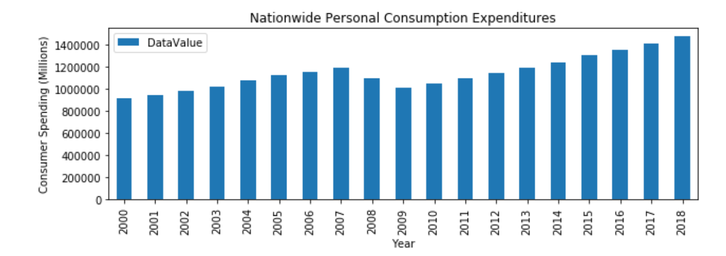
Looking at personal consumption expenditures data from 2000-2018, significant decrease in personal consumption was observed nationwide starting 2008.

Slide 6
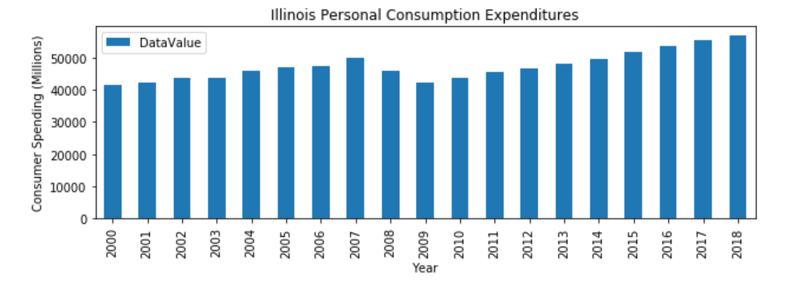
A similar impact is seen in personal consumption during the same period in Illinois.

Slide 7
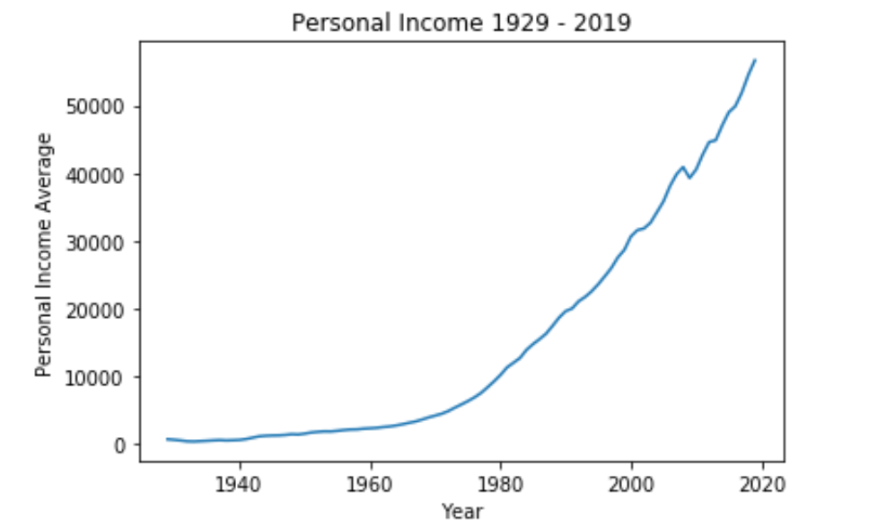
Looking at 90 years of personal income data, shows an upward trend after the economy recovered from the great depression, although there was another noticeable dip around the great recession period.

Slide 8
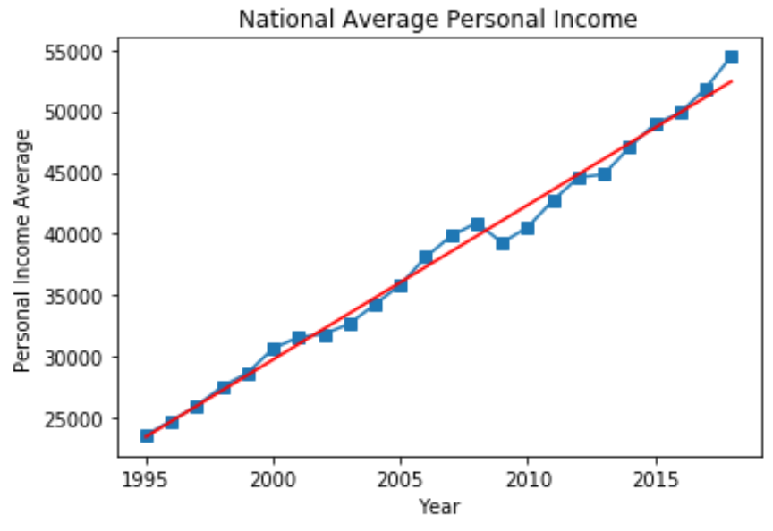
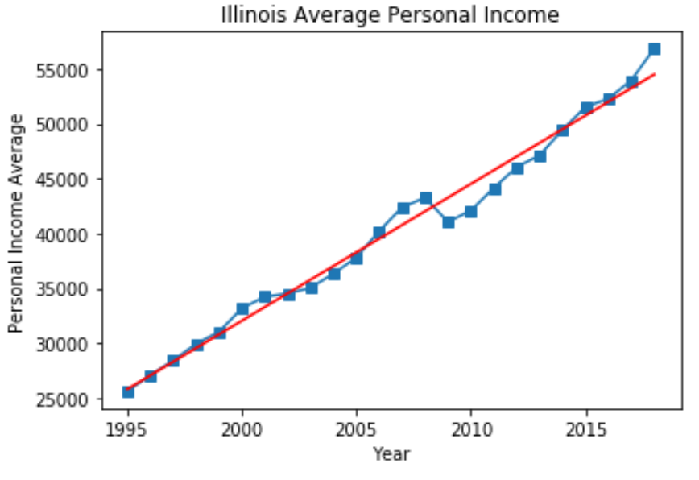
The impact on average personal income was very similar between Illinois and the National average.

Slide 9
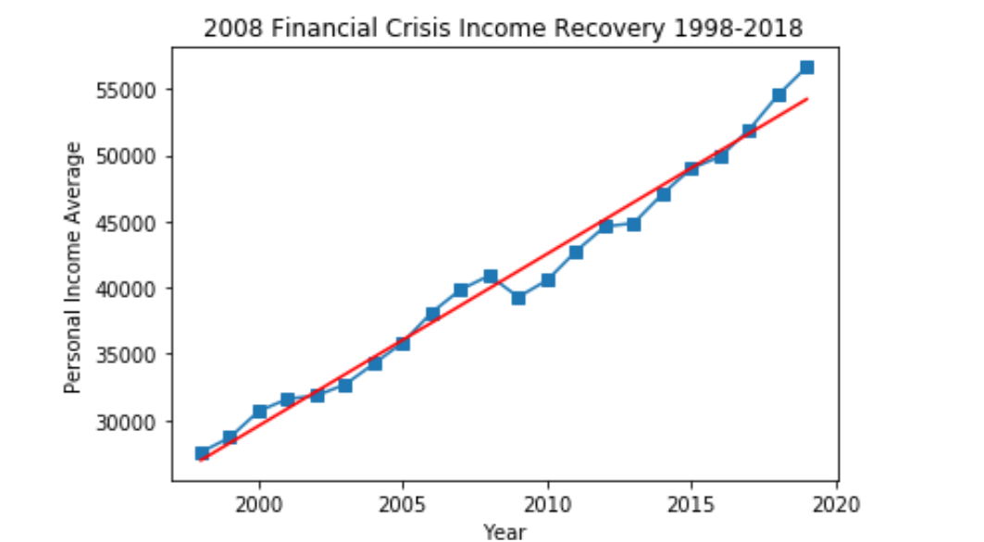
Personal income impacted negatively around 2009, and took around six years to recover.

Slide 10
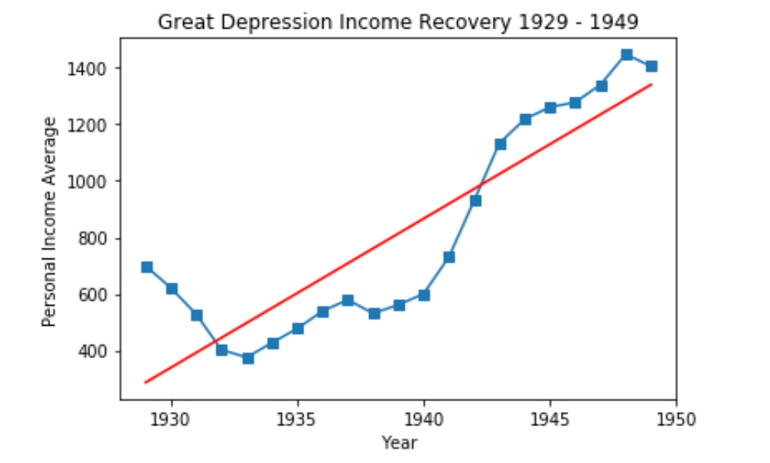
Income recovery during the great depression took ten to eleven years to get back to the previous levels.

Slide 11
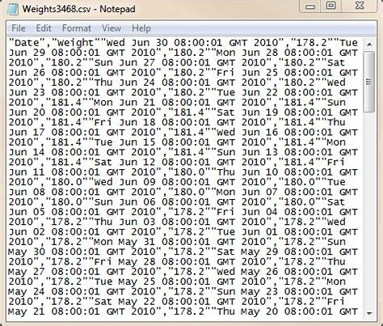
CSV Data Hurdles
Copying a data table from a website
Transforming it into a CSV via excel
Converting into a numeric
Converting to a Data Frame and plotting

Slide 12
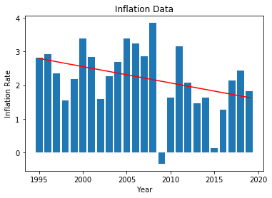
Inflation rate dropped dramatically around 2009.
What is the Federal Reserve's Inflation Target?
According to the Federal Reserve's own statement, the country's central
bank believes that a 2.0 percent annual inflation rate over the medium
term is the best way to maintain maximum employment and price stability.
Higher rates of inflation over time would negatively impact the public’s
ability to make long-term financial decisions.
Conversely, lower rates would lead to deflation and give us a weak
economy with depressed wages and the need for
additional economic policy intervention.
Board of Governors of the Federal Reserve System
The Federal Reserve Board of Governors in Washington

Slide 13
Executive Summary
What We Learned
The key takeaway from this research is that economic crises have noticeable impact on important measures such as income and consumption expenditures. When people are spending money, the economy tends to flourish, but when they hold back the economy tends to contract.
Personal consumption expenditures dropped in 2008, both nationwide and in Illinois.
Looking at 90 years of data showed that average personal income has been on a consistent upward trend.
However, personal income dropped in 2008 and took 6 years to return to the trend line.
Income recovery during the Great Depression took even longer to recover than the 2008 financial crisis, roughly 10-11 years. During those years, world war II occurred and we invested in infrastructure which sowed seeds to build the economy.
Average inflation was negative in 2009 which is typical of weakened economy.

